Slide 1
Corticotropin-Releasing Factor in the BNST
Shaydel Davies

Slide 2
Effects of Social Stress
Social defeat
Increases ethanol consumption
Chronically increases plasma corticosterone levels
Possibly initiated by changes in corticotropin releasing factor

Slide 3
Roles of Corticotropin-Releasing Factor (CRF)
Corticotropin-Releasing Factor (CRF)
Activates the HPA axis
Project to other neural areas
Mediate behavioral responses to stress
Areas include
Amygdala
VTA
BNST

Slide 4
Too Much of a Good Thing…
Overactivity of CRF system leads to
Anxiety
Depression
Alcohol abuse
Up-regulation of CRF
Underlies anxiety phenotypes
Leads to excessive alcohol drinking?

Slide 5
Does CRF in the BNST modulate alcohol consumption?

Slide 6
Variation at the Crhr1 locus and sensitivity to relapse into alcohol seeking induced by environmental stress
Hansson et al., 2006

Slide 7
Some Background
high alcohol preference (msP) rat line
Compared to Wistar rats
Showed upregulation of CRF1 receptor gene
Increased freezing during acquisition and recall fear conditioning
Decreased threshold for stress-induced reinstatement alcohol seeking

Slide 8
CRF mRNA expression
*vs Wistar p<0.01; **p<0.05
N=7-8

Slide 9
CRF1 antagonism (ip) reduced self-administration
*vs Wistar p<0.05
N=7-8

Slide 10
CRF1 antagonism blocked reinstatement in msP
*vs control p<0.05; **p<0.001
#vs extinction p<0.001
N=7-8

Slide 11
Conclusions
CRF1 antagonism decreased acquisition and prevented ethanol reinstatement
In ethanol sensitive rats
No CRF upregulation was found in the BNST

Slide 12
Corticotropin-Releasing Factor within the CeA mediates enhanced ethanol self-administration in withdrawn, ethanol-dependent rats
Funk et al., 2006

Slide 13
Materials and Methods
Wistar rats
180-200g (8wk?)
10% ethanol oral self-administration
FR1 → 0.1ml liquid
30min access 5 days/week
Ethanol vapor exposure
Pumped into cages for 14hr/day
CRF immunoreactivity
Brains taken after 4wk ethanol exposure

Slide 14
CRF infusion had no effect on ethanol self administration
*vs nondependent p<0.0001
N=8-9

Slide 15
Ethanol Vapor Exposure had No Effect on CRF neuron density
P=0.08
N=3

Slide 16
Ethanol Vapor Exposure had No Effect on CRF neuron density

Slide 17
Conclusions
CRF infusions into the BNST did not alter ethanol self-admin
Ethanol vapor exposure did not alter BNST CRF density
However:
CRF infusions in CeA increased ethanol self-admin
Ethanol vapor exposure decreased CeA CRF density

Slide 18
Corticotropin Releasing Factor in the BNST in Socially Defeated and Non-stressed Mice with a History of Chronic Alcohol Intake
Alberecht-Souza et al., 2017

Slide 19
Experimental Timeline

Slide 20
Materials and Methods
C57BL/6 mice- 8wk
Social Defeat Paradigm
10 consecutive days
5min separated
Physical interaction “until 5 bites received”
10min separated

Slide 21
Materials and Methods
“Sweet Solution Two-Bottle Choice”
50-ml bottle 1% saccharin solution
90min access
First defeat
Last defeat
7 days post last defeat
EPM
8 days after last social defeat
TST
9 days after last social defeat

Slide 22
Materials and Methods
Ethanol Two-Bottle Free Choice Paradigm
50ml 20% ethanol
10 days after last defeat
Continuous access for 4 weeks
Ethanol Testing During Drug Manipulations
Access given 10min post infusion
Consumption measured at 2-, 4-, and 24-hr

Slide 23
Materials and Methods
Bilateral infusions into BNST
CRF1 antagonist- CP376,395
0.25 and 0.5µg / side
CRF2 antagonist- astressin2B
0.25 and 0.5µg / side
3 infusions, 48hr apart
Blood Ethanol Concentration (BEC)
48hr continuous access

Slide 24
Social Defeat had No Effect on Body Weight
p=0.46
n=36-37

Slide 25
Social Defeat Transiently Increased Sweet Solution Intake
*p=0.00?
N=12

Slide 26
Social Defeat had No Effect on Water Intake
p=0.1
N=12

Slide 27
Social Defeat Decreased Open Arm Entries
*p=0.03
N=12

Slide 28
Social Defeat Decreased Time in Open Arms
*p=0.04
N=12

Slide 29
Social Defeat Yielded No Change in Closed Arm Entries
p=0.9
N=12

Slide 30
Social Defeat Did Not Alter TST
p=0.78
N=12

Slide 31
Social Defeat Increased Voluntary Ethanol Drinking
*p=0.02
N=12

Slide 32
Social Defeat Did Not Alter Water Intake
p=0.85 between groups
P=0.00? Over time
N=12

Slide 33
Experimental Paradigm for mRNA study

Slide 34
Social Defeat Increased BNST CRF mRNA expression
*p=0.03
N=11-12

Slide 35
Social Defeat had No Effect on BNST CRF₁ Receptor mRNA
*p=0.73
N=12

Slide 36
Social Defeat had No Effect on BNST CRF₂ Receptor mRNA
*p=0.25
N=12

Slide 37
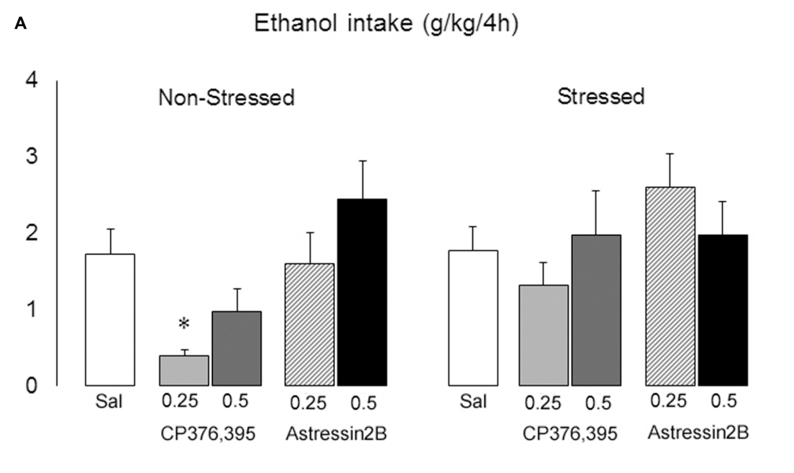
CRF Antagonism on Acute Ethanol Consumption
*vs saline p=0.00?
N=11-20

Slide 38
CRF Antagonism on 24hr Ethanol Consumption
*vs saline p=0.06
#vs non-stressed saline p=0.00?
N=11-20

Slide 39
CRF Antagonism on Acute Water Consumption
*vs saline p=0.22
N=11-20

Slide 40
CRF Antagonism on 24 Water Consumption
*vs saline p=0.09
N=11-20

Slide 41
Conclusion
Social defeat
increased saccharin consumption
Immediately following, lost 7 days post
In EPM, decreased open arm entries/time spent
Increased ethanol consumption
Increased CRF mRNA
CRF₂ antagonism
Low dose increased 24 ethanol consumption in defeated animals

Slide 42
Does CRF in the BNST modulate ethanol consumption?
Background papers say no
Alberecht says yes
Is the difference a social stessor?

